Slide 1

Shopify and Its Business Model
Presented by:
Fatima Aftab
Basit Iqbal
Waleed Rasheed

Slide 2
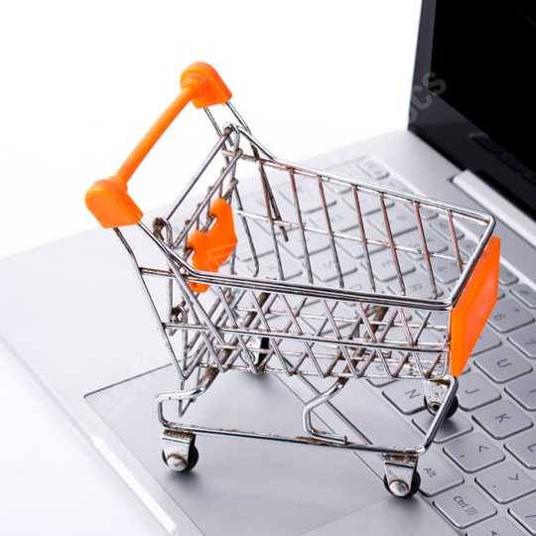


Agenda
Introduction to the Business Model
Introduction to Shopify
Business Model of Shopify
Revenue Streams of Shopify
How users earn money
Marketing Tools for Shopify Users
Managing Inventory and Shipping
Shopify's Future

Slide 3



Introduction to Business Model
A business model is a plan or strategy that outlines how a company will generate revenue, make profits, and sustain its operations over time. It describes how a business creates, delivers, and captures value in the market. A business model includes key elements such as the target customers, the value proposition, the revenue streams, the cost structure, and the channels through which the business interacts with its customers. Essentially, a business model is a blueprint for how a company makes money and operates.

Slide 4

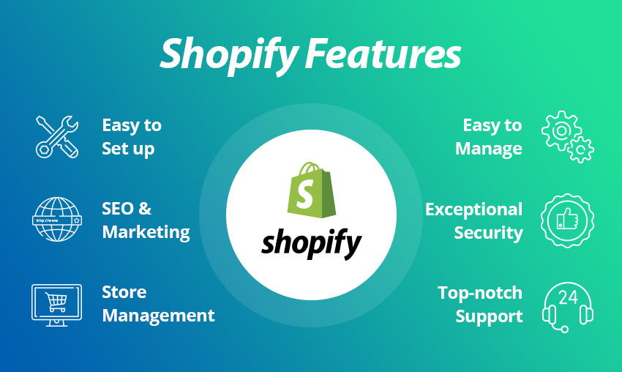
Introduction to Shopify
Shopify is a platform that allows people to easily create an online store to sell products. It provides everything needed to set up and run an online store, including website design templates, payment processing, inventory management, and marketing tools. Shopify is designed to be user-friendly and accessible to people without technical skills, making it a popular choice for small business owners and entrepreneurs. With Shopify, anyone can start an online store and reach customers all over the world.

Slide 5
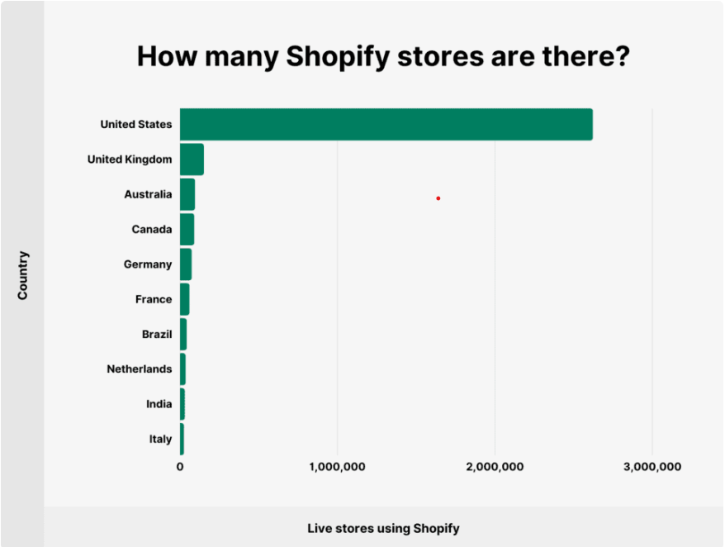

How many Shopify stores are there?
3.76 million live websites use Shopify. Most domains (69.67%) are registered in the United States. The United Kingdom and Australia complete the top 3.

Slide 6

Business Model of Shopify
The business model of Shopify can be summarized in the following points:
Provides a platform for people to create and run online stores.
Charges users a monthly fee for access to the platform.
Takes a percentage of each transaction made through the platform.
Additional paid services, such as custom design and marketing tools, are offered for additional revenue.
Aims to provide a low-cost, easy-to-use platform for entrepreneurs and small businesses to launch and grow their online stores.

Slide 7



Revenue Streams of Shopify
1
Subscription Fees
Shopify charges its users a monthly subscription fee to use its platform and services ranging from $29 to $299 per month depending on the plan
2
Transaction Fees
Shopify also charges a transaction fee for each sale made through its platform ranging from 0.5% to 2% depending on the plan. However, users can lower this fee by using Shopify’s own payment gateway.
3
Add-Ons & Services
Shopify offers a variety of add-ons and services to its users, such as custom domains, SSL certificates, and shipping and accounting integrations

Slide 8
The Shopify Subscription Model
Basic Plan
Shopify
For small, new businesses just starting out online.
For growing businesses looking to scale up their e-commerce operations.
Advanced Shopify
Shopify Plus
For established businesses with high volumes of sales.
For enterprise-level businesses with custom needs and features.

Slide 9



Transaction Fees on Sales Made Through Shopify
Shopify charges a transaction fee of between 0.5% and 2.0% depending on the subscription plan, in addition to payment processing fees charged by payment providers like PayPal or Stripe.
Payment Providers
Mobile Commerce
Customer Services
Shopify integrates with more than 100 payment providers allowing businesses to choose the provided that suits their needs
Shopify's mobile app allows business to manage their store on the go and enables customers to make purchases on mobile devices
Shopify provides 24 by 7 support to businesses and can help with everything from setting up a store to customizing the design

Slide 10

Add-Ons & Services
Add-Ons:
Add-ons in Shopify are extra features that customers can add to their online store to make it more functional.
Example:
For example, if a customer wants to accept payments in multiple currencies, they can use a currency conversion add-on.
Services:
Services in Shopify are professional services that help customers build, launch, and grow their online businesses. This might include services like designing the online store, setting up marketing campaigns, or developing custom apps. Customers pay Shopify for these services either on a project basis or an ongoing basis.
Example:
Store Design Services, Marketing Services, App Development Services, and Payment and Shipping Services

Slide 11

How Shopify users earn money
Shopify users earn money by setting up an online store and selling products or services. They can customize their store design and use marketing tools to attract customers. Shopify provides payment processing and shipping solutions, making it easy for businesses to manage their operations.

Slide 12
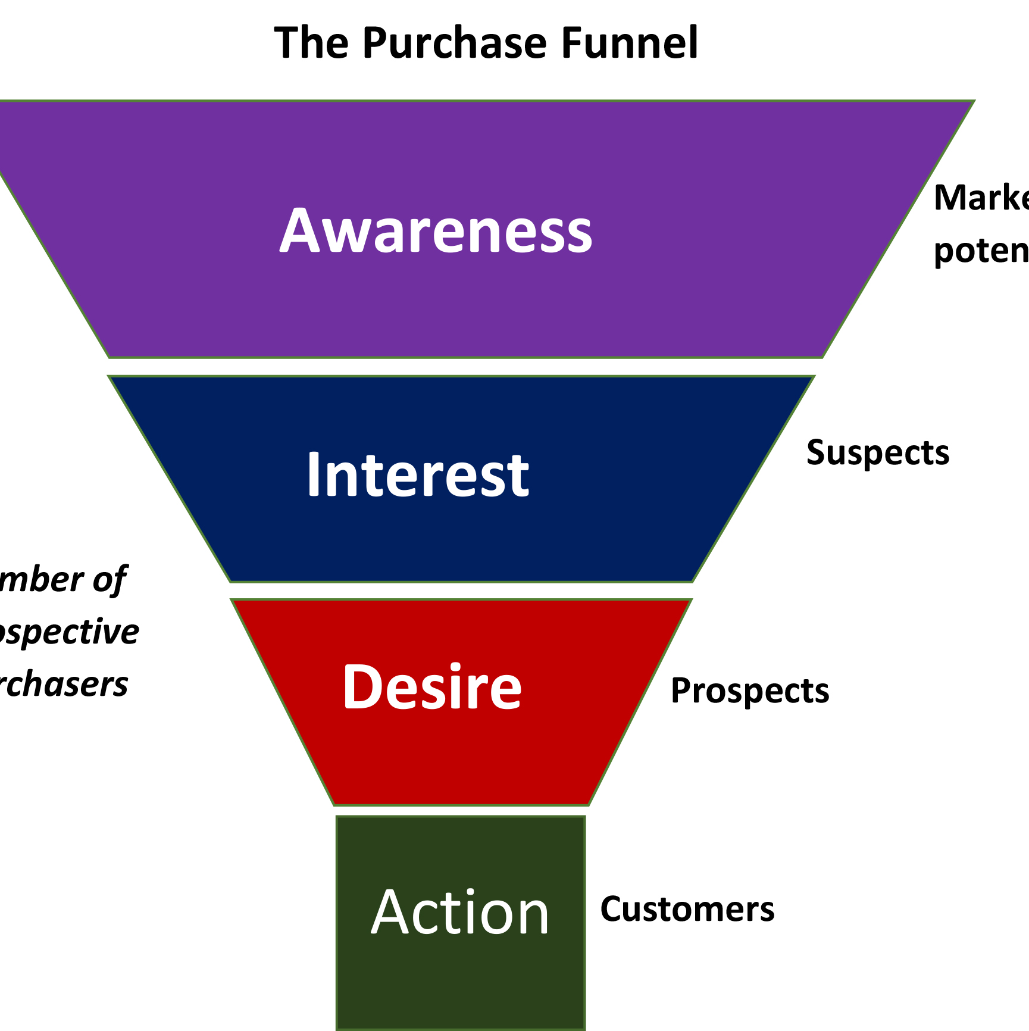

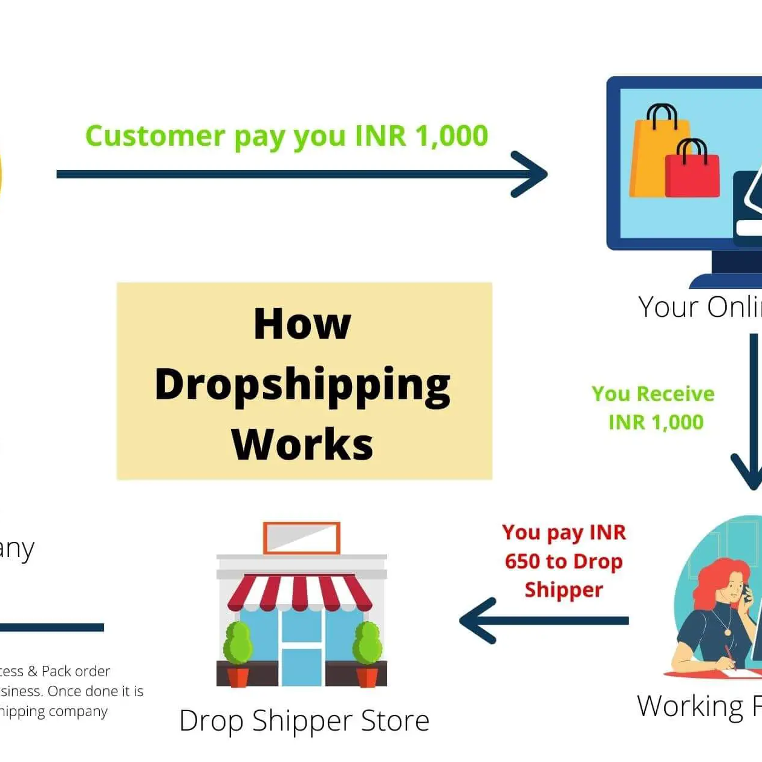

Continue…
Sales Funnel
Users can create a sales funnel on Shopify to increase their revenue, such as by offering upsells or discounts for multiple purchases.
Affiliate Marketing
Shopify allows users to create an affiliate program and incentivize users to promote their products.
Drop shipping
Users can use Shopify's drop shipping integration to sell products from third-party suppliers without holding inventory.
Subscription Model
Users can set up a subscription model on Shopify to provide predictable revenue and create a loyal customer base.

Slide 13
Marketing Tools for Shopify Users
SEO Optimization
Email Campaigns
Shopify's email campaign tool allows businesses to design and send newsletters, abandoned cart emails, and more.
Shopify integrates with popular social media platforms like Facebook and Instagram, allowing businesses to advertise and sell products directly to customers.
Shopify provides businesses with tools to optimize their store's search engine visibility, including customizable meta tags and sitemaps.
Social Media Integration

Slide 14
Managing Inventory and Shipping
Shopify provides businesses with tools to manage their inventory and shipping needs. Businesses can track inventory levels, set up shipping rates, and print shipping labels all from one platform.
Inventory Management Shopify provides a range of inventory management tools that help businesses keep track of stock levels, manage purchase orders, and track sales trends.
Shipping Services Shopify provides integration with a range of shipping providers, allowing businesses to choose the one that best suits their needs.

Slide 15


Future of Shopify
1
Continued Growth
Shopify's user base and revenue continue to grow year over year, indicating a promising future for the company.
2
Expansion into New Markets
Shopify has expanded beyond its e-commerce platform to provide additional services such as point-of-sale solutions and marketing tools.
3
Innovative Features
Shopify is constantly innovating, with new features such as augmented reality and voice search to improve the user experience.

Slide 16

Thank You
Fatima Aftab
Basit Iqbal
Waleed Rashid

